Slide 1
Merging Stylometry and Markup
Patrick Juola
Evaluating Variations in Language Lab
Duquesne University

Slide 2
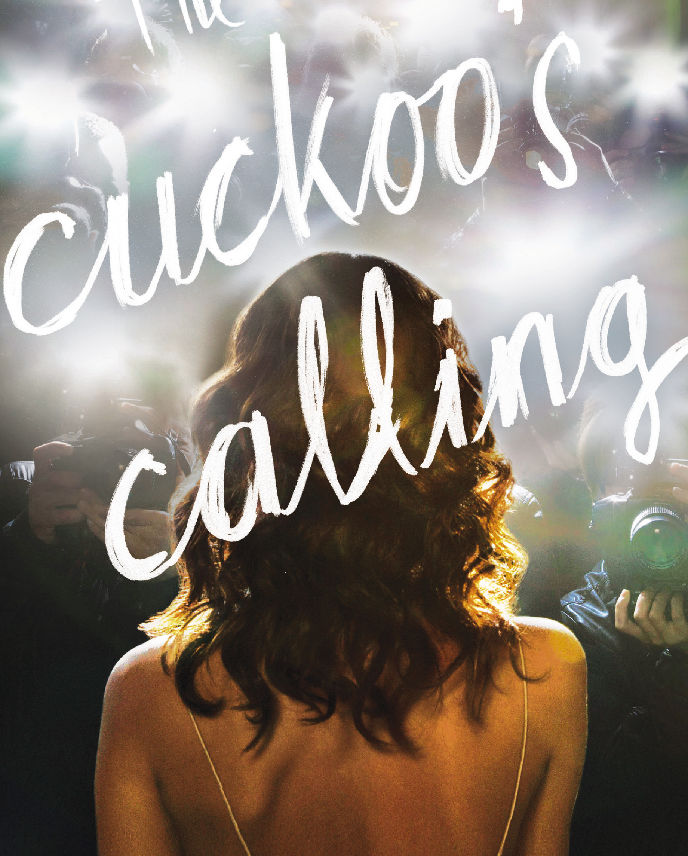
Stylometry: The Case of The Cuckoo’s Calling
Published April 30, 2013
Author named as Robert Galbraith
Acknowledged pseudonym
Author suggested on Twitter as J.K. Rowling

Slide 3
Stylometry is …
… a classic problem in scholarship, including literature, forensic/legal, and historical scholarship
Given a document, who wrote it?
Increasing research area with substantial body of work
Sometimes called authorship attribution

Slide 4
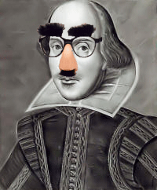
Whodunit?
Did Shakespeare really write those plays?
Or was it the Earl of Oxford?
Or Francis Bacon?
Or Roger Bacon?
Or Kevin Bacon?
et cetera
How can we tell?
How can we prove it?

Slide 5
How to find authors 101
Document prep
Training documents (KD)
Test documents (QD)
Feature Selection
Identify author-specific features
Words, character clusters, &c.
Classify
Apply ML techniques
k-NN, SVM, PCA, &c.

Slide 6
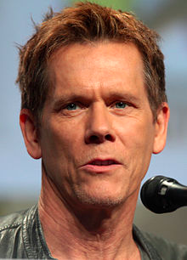
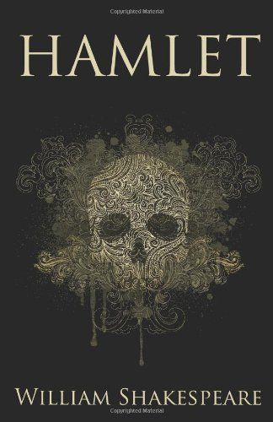
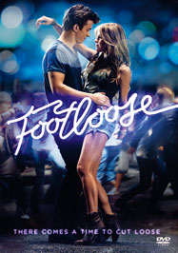
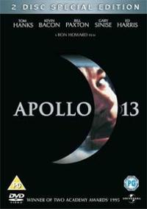
How it works

Slide 7
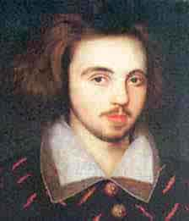
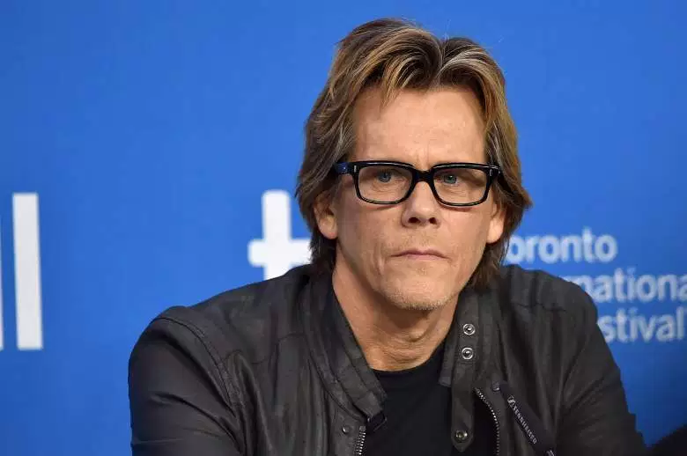
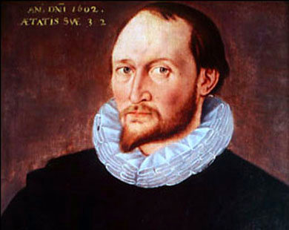
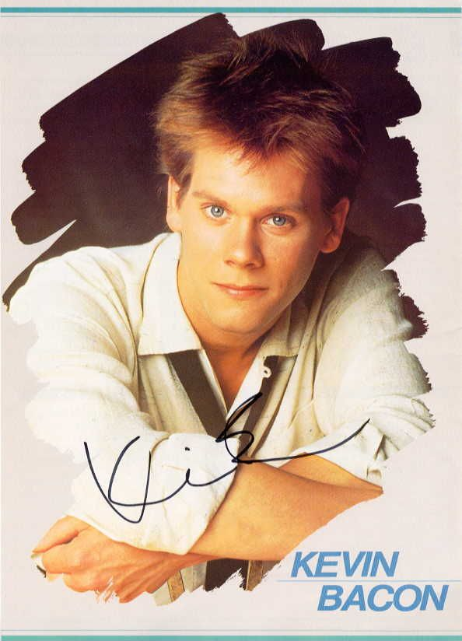
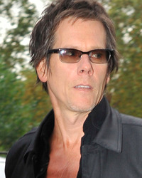
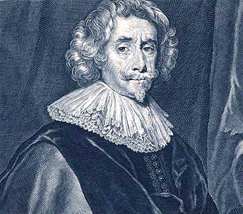
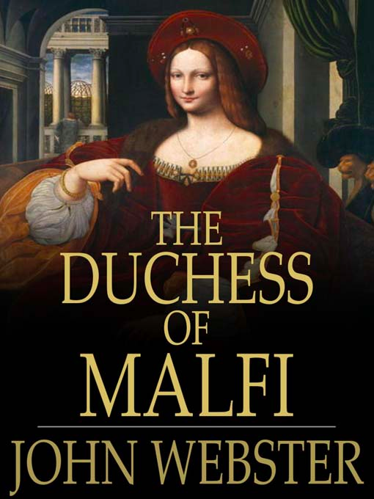
Works on groups, too
This is called “profiling”

Slide 8
Lots of profiling options
Gender
Age
Education level
Socio-economic status
Native language
Mental traits like personality
… really, only limited by imagination (and data)

Slide 9
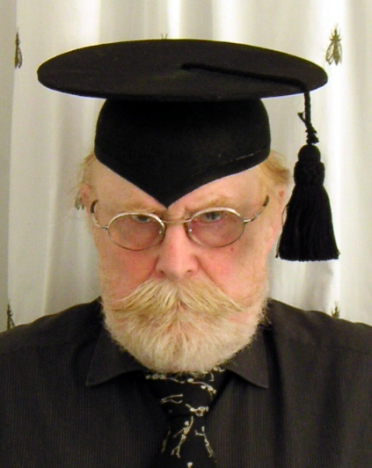
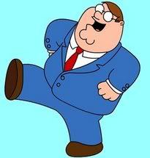
What kind of “features”?
The paradigmatic and systematic utilization of sesquipedalian lexical items can be an informative element of individual and idiosyncratic patterns of linguistic variation
Or, some people use big
words

Slide 10
Word length as cue
“Try to balance in your own mind the question whether the latter [text] does not deal in longer words than the former [text]…. Some of these days spurious writings will be detected by this test.” (August de Morgan, 1851)
Statistically, calculate average word length and use ordinary stats (t-tests)

Slide 11
The issue
The issue is that it doesn’t work (well).
Like classifying people by height—almost everyone is average
Word length isn’t stable, either.
I write differently to friends than to journals.
If word length won’t work, what else will?

Slide 12
Successful feature sets
A good feature set is
common
stable
informative
computationally tractable
Most success so far with variations on words and character clusters.

Slide 13
Function words
One possibility : function words
The, that, of, as, between, among, etc.
Short, common, light on meaning
Stable across texts
Many types, allowing for multivariate statistics and high discriminative power

Slide 14
The Case of The Royal Book of Oz

Slide 15
Historical synopsis
Baum wrote “Wizard of Oz” in 1900; 13 more books by 1919.
15th book (“Royal Book”) unfinished at his death, Ruth Plumly Thompson took “fragmentary draft” and “unfinished notes” to complete and publish
Published 1921 with Baum’s name on cover, “enlarged and edited” by Thompson

Slide 16
Historical revisionism
Or did she?
Alternate view : “Royal Book” was entirely Thompson’s work. Story about “unfinished notes” and Baum’s name used by publisher to strengthen sales.
Thompson went on to publish nearly 20 more Oz books under her own name.

Slide 17
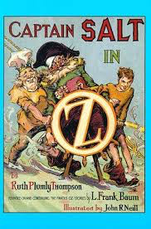
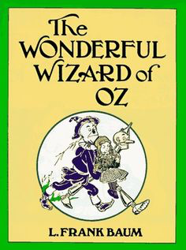

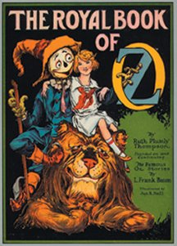
(Betcha didn’t know that Baum was really Kevin Bacon!)

Slide 18
Binongo analysis
Collect 50 “most frequent words”
Candidates include the, and, to, not, as, with, before, after, some, well, back, how
Apply stats (PCA) to perform “dimensionality reduction,” essentially making 2D image from 50D data.

Slide 19
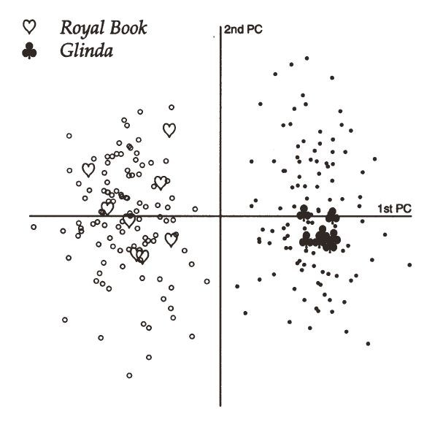
Baum is on right
So who wrote Royal Book?

Slide 20
Which attributes? Which features?
Tech can be deployed to address many types of questions….
… but useful feature sets are limited
Characters
Words
Part-of-speech tags
Tend to be low-level and uninteresting from a literary p-o-v.

Slide 21
Markup and Stylometry
… have not historically had much to do with each other
… which is unfortunate
Can markup help stylometrists?
Can stylometry help the markup process?

Slide 22
Markup is …
… making subtle properties (“features”) obvious to computers
Key problem with sophisticated feature sets is reliability

Slide 23
How confident are we?
We are 100% accurate of a UTF-8 ‘A’
We are about 99% confident of a typed/scanned ‘A’
POS tagging is 98% accurate (56% per sentence)
Shallow parsing is 90% accurate
… and it only goes downhill from there

Slide 24
Language is <whine>hard</whine>!
The council refused a permit to the women because they advocated violence.
The council refused a permit to the women because they feared violence.
Good luck with that, Google Translate!

Slide 25
Yup, Google muffed it!
The council refused a permit to the women because they feared violence.
Le conseil a refusé un permis aux femmes parce qu'elles craignaient la violence.
Requires human expertise
Computer “just” applies model
But the computer’s mistakes are exactly where an individual writing differs from the computational model!

Slide 26
Where markup can help
<epigram>Markup makes the inobvious obvious.</epigram>
Allows stylometric focus on properties that are not “tractable”
Human accuracy is higher than machine
Example: Phonetics. “The tough coughs as he ploughs through the dough.”

Slide 27
Pushing feature sets
… into the realm of usefulness
No one cares about Mitford’s use of “that” vs. “which.”
What do Mitford scholars care about? Learning about useful properties of Mitford’s world can improve our ability both to understand and to detect her.

Slide 28
Upcoming workshop
Practice problems to demonstrate stylometric analysis
Will discuss approaches and limitations
… and you get a copy of the software to play with if you like
Feel free to “bring your own data”

Slide 29
Summary and conclusions
Stylometry is an important DH topic
The stylometric and markup communities have not generally had much to do with each other
… which is unfortunate
We need to discuss common interests and common tasks to help find common solutions

Slide 30
So let’s start discussing!
Thank you very much!
Patrick Juola
juola@mathcs.duq.edu

